Slide 1
Unit V - Quality Assurance and Testing of the Design, Maintaining the Embedded systems
CSPC61 - Embedded Systems Architectures
Dr. M. Bhuvaneswari
22.04.2022

Slide 2
Quality Assurance and Testing of the Design
Goal - Testing and assuring the quality of a system - finding bugs within a design and tracking whether the bugs are fixed.
Quality assurance and testing is similar to debugging except that the goals of debugging are to actually fix discovered bugs.
Main difference - Debugging occurs when the developer encounters a problem in trying to complete a portion of the design and tests-to-pass the bug fix. Tests only to ensure the system minimally works under normal circumstances.
Testing - bugs are discovered as a result of trying to break the system, including both testing-to-pass and testing-to-fail, where weaknesses in the system are probed.
Bugs usually stem from either the system not adhering to the architectural specifications or the inability to test the system.

Slide 3
Quality Assurance and Testing of the Design
The types of bugs encountered in testing depend on the type of testing being done.
Testing techniques fall under one of four models.
static black box testing, static white box testing, dynamic black box testing, or dynamic white box testing
Black box testing occurs with a tester that has no visibility into the internal workings of the system.
Black box testing is based on general product requirements documentation.
white box testing (clear box or glass box testing) in which the tester has access to source code, schematics, and so on.
Static testing is done while the system is not running.
Dynamic testing is done when the system is running.

Slide 4
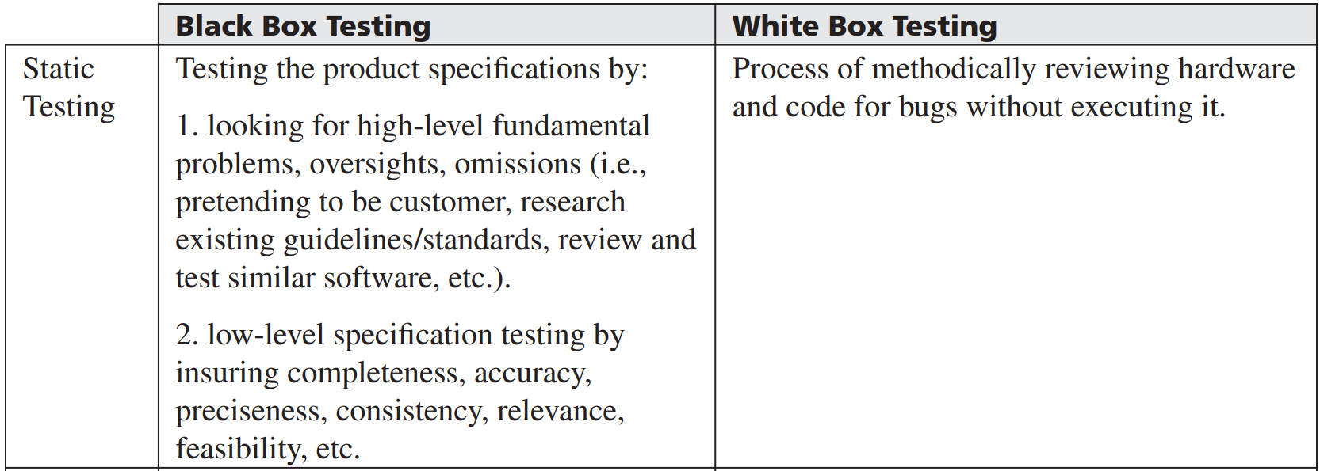
Quality Assurance and Testing of the Design

Slide 5
Quality Assurance and Testing of the Design
 | Black Box Testing | White Box Testing
Dynamic Testing | Requires definition of what software and hardware does, includes: data testing, boundary condition testing, internal boundary testing, input testing, state testing | Testing running system while looking at code, schematics, etc. Directly testing low-level and high-level based on detailed operational knowledge, accessing variables and memory dumps. data reference errors, data Declaration computation errors, comparison errors, control flow errors, sub-routine parameter errors, I/O error

Slide 6
Quality Assurance and Testing of the Design
Testing can be further broken down to include unit/module testing.
compatibility testing - testing that the element doesn’t cause problems with other elements in the system.
Integration testing - incremental testing of integrated elements.
System testing - testing the entire embedded system with all elements integrated)
Regression testing - Rerunning previously passed tests after system modification.
Manufacturing testing - testing to ensure that manufacturing of system didn’t introduce bugs.
From these types of tests, an effective set of test cases can be derived that
Verify that an element and/or system meets the architectural specifications.
Validate that the element and/or system meets the actual requirements.

Slide 7
Quality Assurance and Testing of the Design
Once the test cases have been completed and the tests are run, how the results are handled can vary depending on the organization.
Formal design reviews, or peer reviews where fellow developers exchange elements to test.
Walkthroughs where the responsible engineer formally walks through the schematics and source code
Inspections where someone other than the responsible engineer does the walk through, and so on.
Specific testing methodologies and templates for test cases, as well as the entire testing process, have been defined in several popular industry quality assurance and testing standards.
ISO9000 Quality Assurance standards, Capability Maturity Model (CMM), and the ANSI/IEEE 829 Preparation, Running, and Completion of Testing standards.

Slide 8
Quality Assurance and Testing of the Design
There a wide variety of automation and testing tools and techniques that can aid in the speed, efficiency, and accuracy of testing various elements.
Load tools, stress tools, interference injectors, noise generators, analysis tools, macro recording and playback, and programmed macro.

Slide 9
Maintaining the Embedded System
After an embedded device has been deployed, there are responsibilities that need to be met, such as user training, technical support, providing technical updates, bug fixes, and so on.
user training - architecture documentation – user manual
Architecture documentation can also be used to assess the impact involved in introducing updates.
Creating an architecture addresses these requirements very early in a project, allowing a design team to mitigate risks.
Architecture of an embedded device - one of the most critical elements of any embedded system project.
Configuration Management - ensuring that all software and hardware components need to be tracked at all times. Version control systems – practice of tracking and managing changes in hardware and software components of an Embedded systems.

